Slide 1

Telecom Churn Prediction
Group Members: Alexey, Deena, Lamees, Rizwan

Slide 2


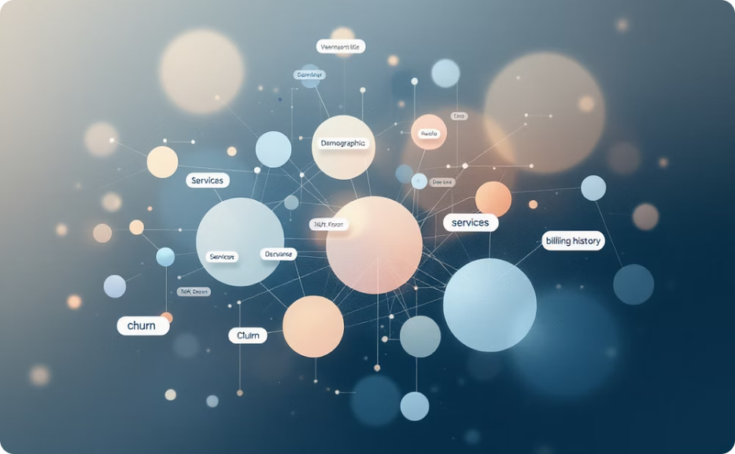

Churn Prediction
Total Customers
Rich Data Points
Predicting Churn
Analyzing a diverse dataset of telecom users.
Comprehensive data on demographics, services, billing, and churn labels.
Our primary goal is to predict customer churn and identify key influencing factors.

Slide 3










Which Customers Are More Likely to Churn?
Month-to-Month Contracts
Fiber Optic Internet
No Support Services
Customers with short-term commitments are more prone to switching providers.
Users of this premium service may have higher expectations and less tolerance for issues.
Lack of online security, backup, or tech support increases vulnerability to dissatisfaction.
High Monthly Charges
Low Tenure
Customers paying more are often more sensitive to value and potential cost savings elsewhere.
New customers, still evaluating the service, are at higher risk of leaving.

Slide 4
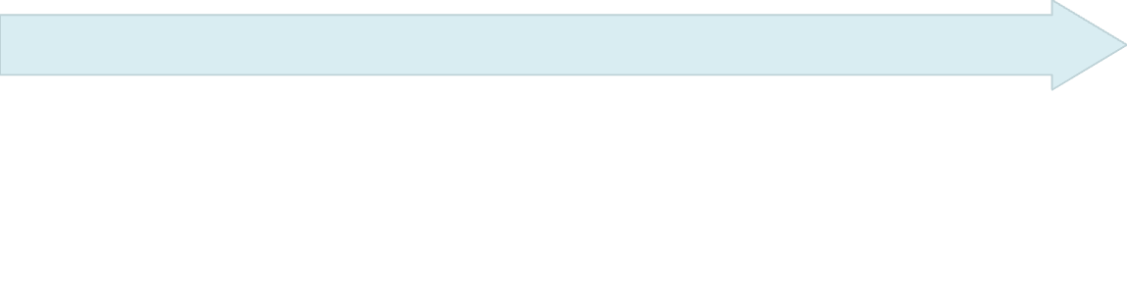






Key Churn Drivers
Internet Service
Tenure
Fiber optic internet users have high expectations and low tolerance for service issues.
Contract Type
New customers, still evaluating the service, are at higher risk of leaving.
Short-term contracts reduce commitment, making it easier for customers to switch providers.
Billing Factors
Support Services
High monthly charges, especially with electronic check payments, elevate churn risk.
Lack of online security, backup, or tech support increases dissatisfaction.

Slide 5
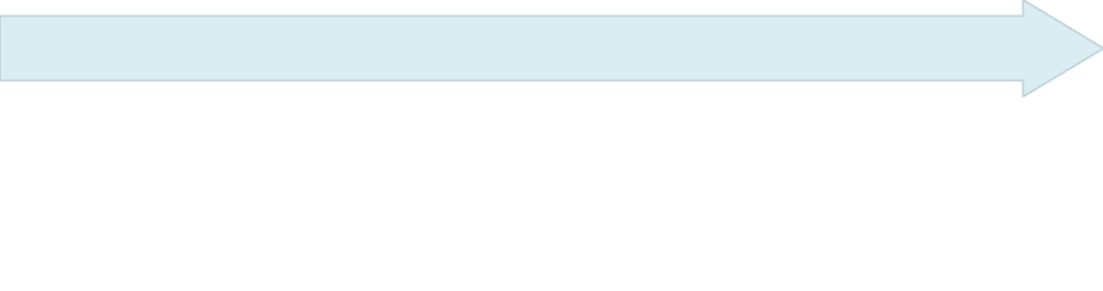





Recommendations to Reduce Churn
Bundle online security, backup solutions, and tech support to enhance perceived value.
Enhance onboarding to quickly engage new customers and ensure early satisfaction.
Offer attractive discounts or added value for annual contracts to boost loyalty and reduce churn.
Identify and proactively engage high-risk customers to address concerns before churn occurs.
Re-evaluate high-cost service plan pricing for competitiveness and fairness.

Slide 6
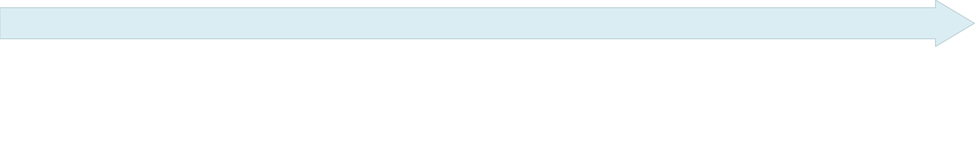





Methodology
Visualization
Data Analysis
Feature Engineering
Model

Slide 7
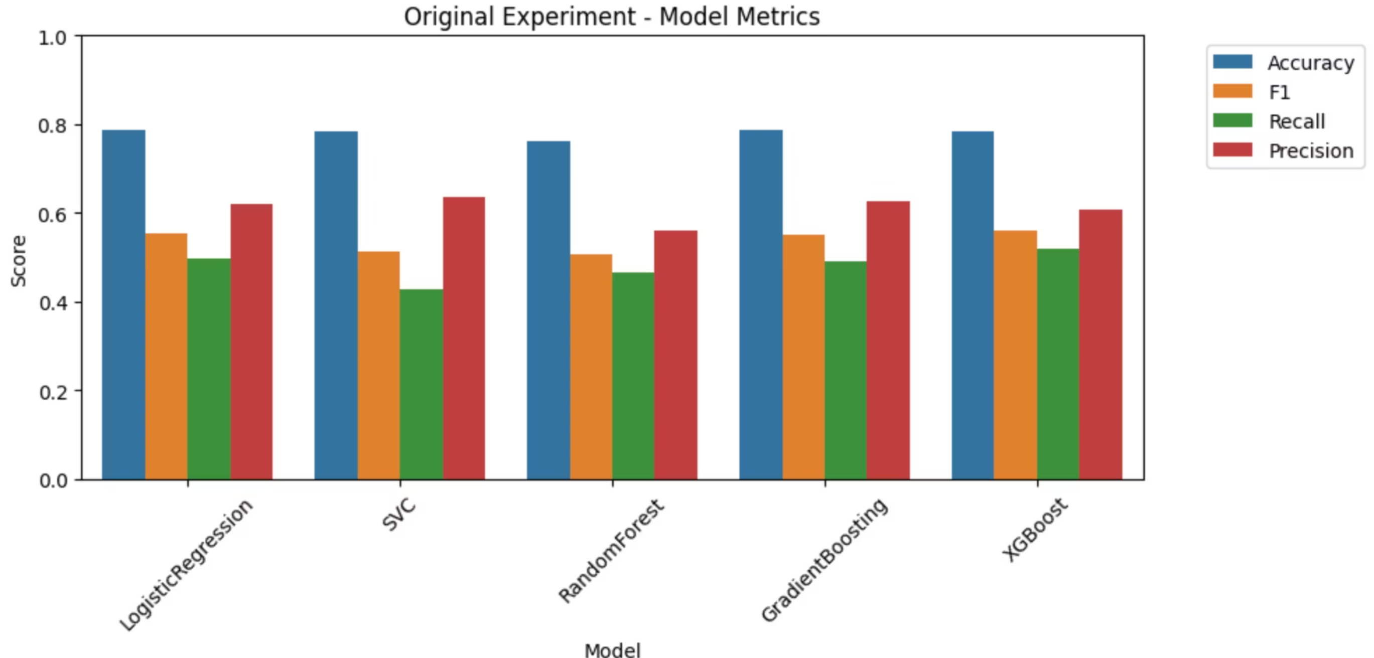
Model Comparison

Slide 8
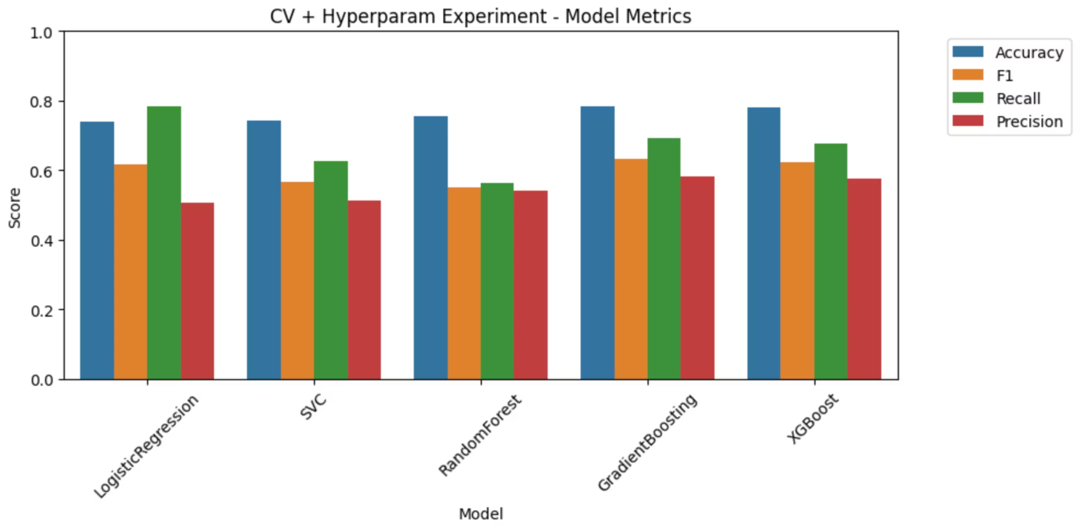
CV and Hyperparam

Slide 9
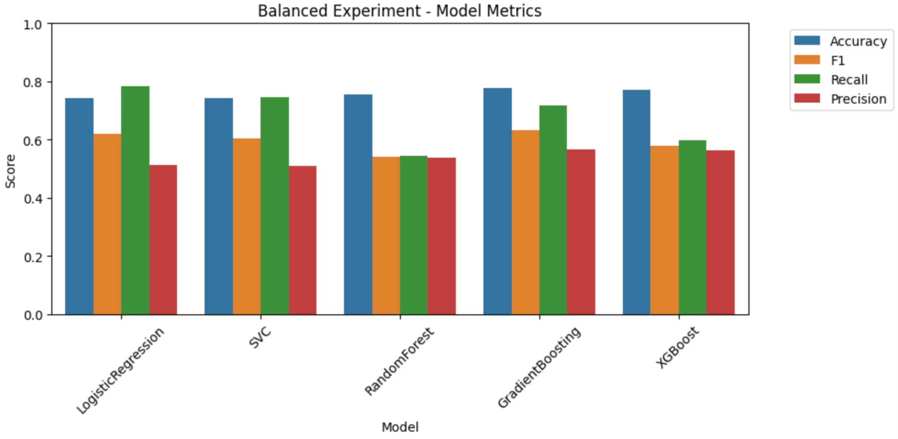
Balanced Experiment

Slide 10
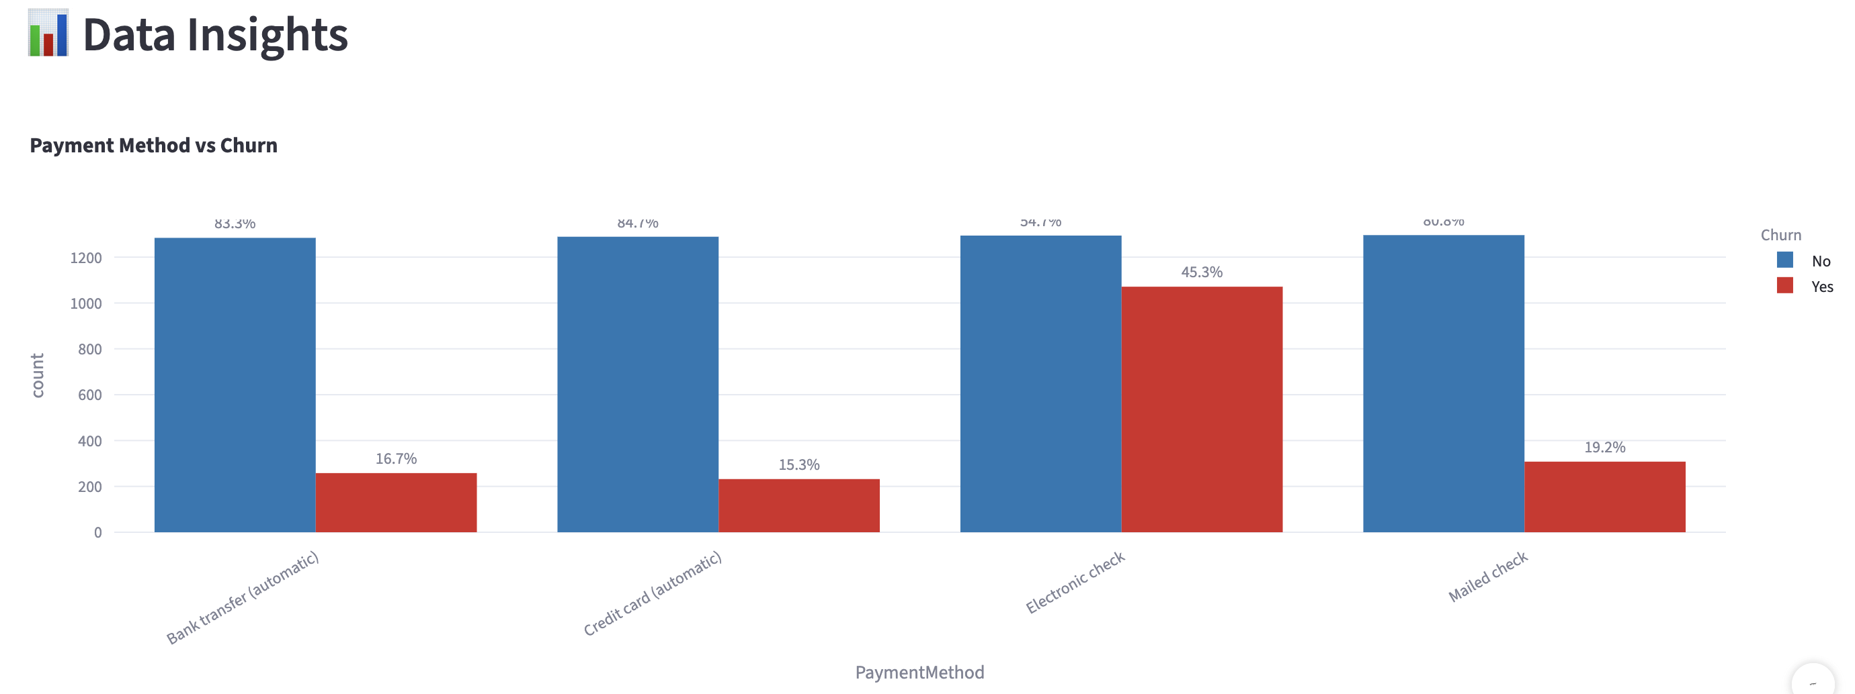
Payment method and Churn

Slide 11
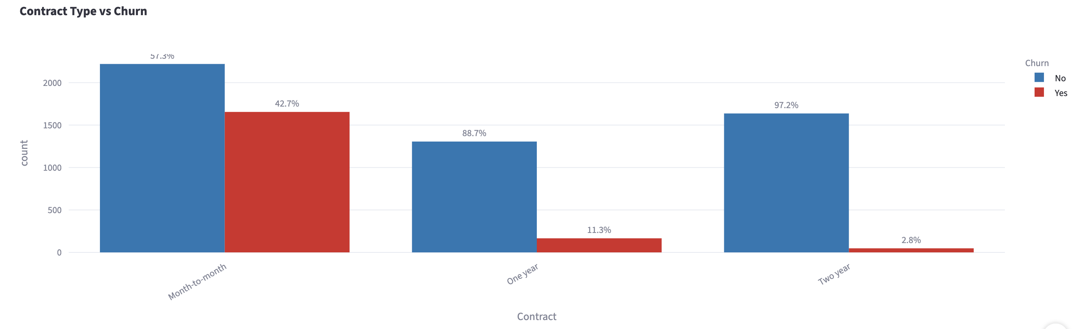
Contract and Churn

Slide 12
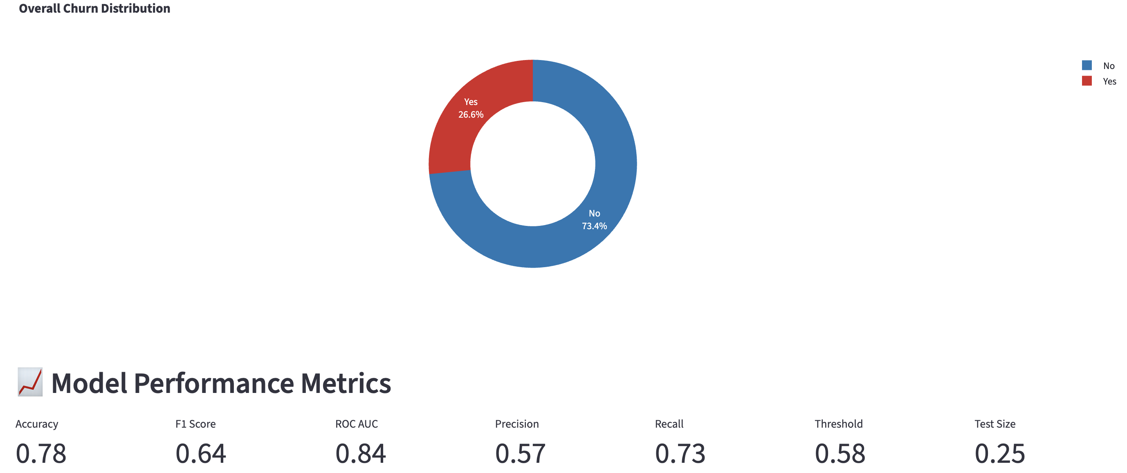
Churn Distribution

Slide 13


Future Work
SHAP & Feature Importance
Extended Dataset & Behavioral Features
Enhance model explainability with SHAP or feature importance visualizations.
Improve prediction accuracy by extending the dataset with more behavioral features.

Slide 14

Questions
Let's explore your questions and discuss our findings.

